Slide 1
WTO MC 13 and the EU
Bocconi Webinar on WTO MC 13
Matthias Goldmann Chair of International Law, EBS Law School

Slide 2
Open Strategic Autonomy
Trade policy since 2021
Open?
Strategic?
Autonomy?

Slide 3
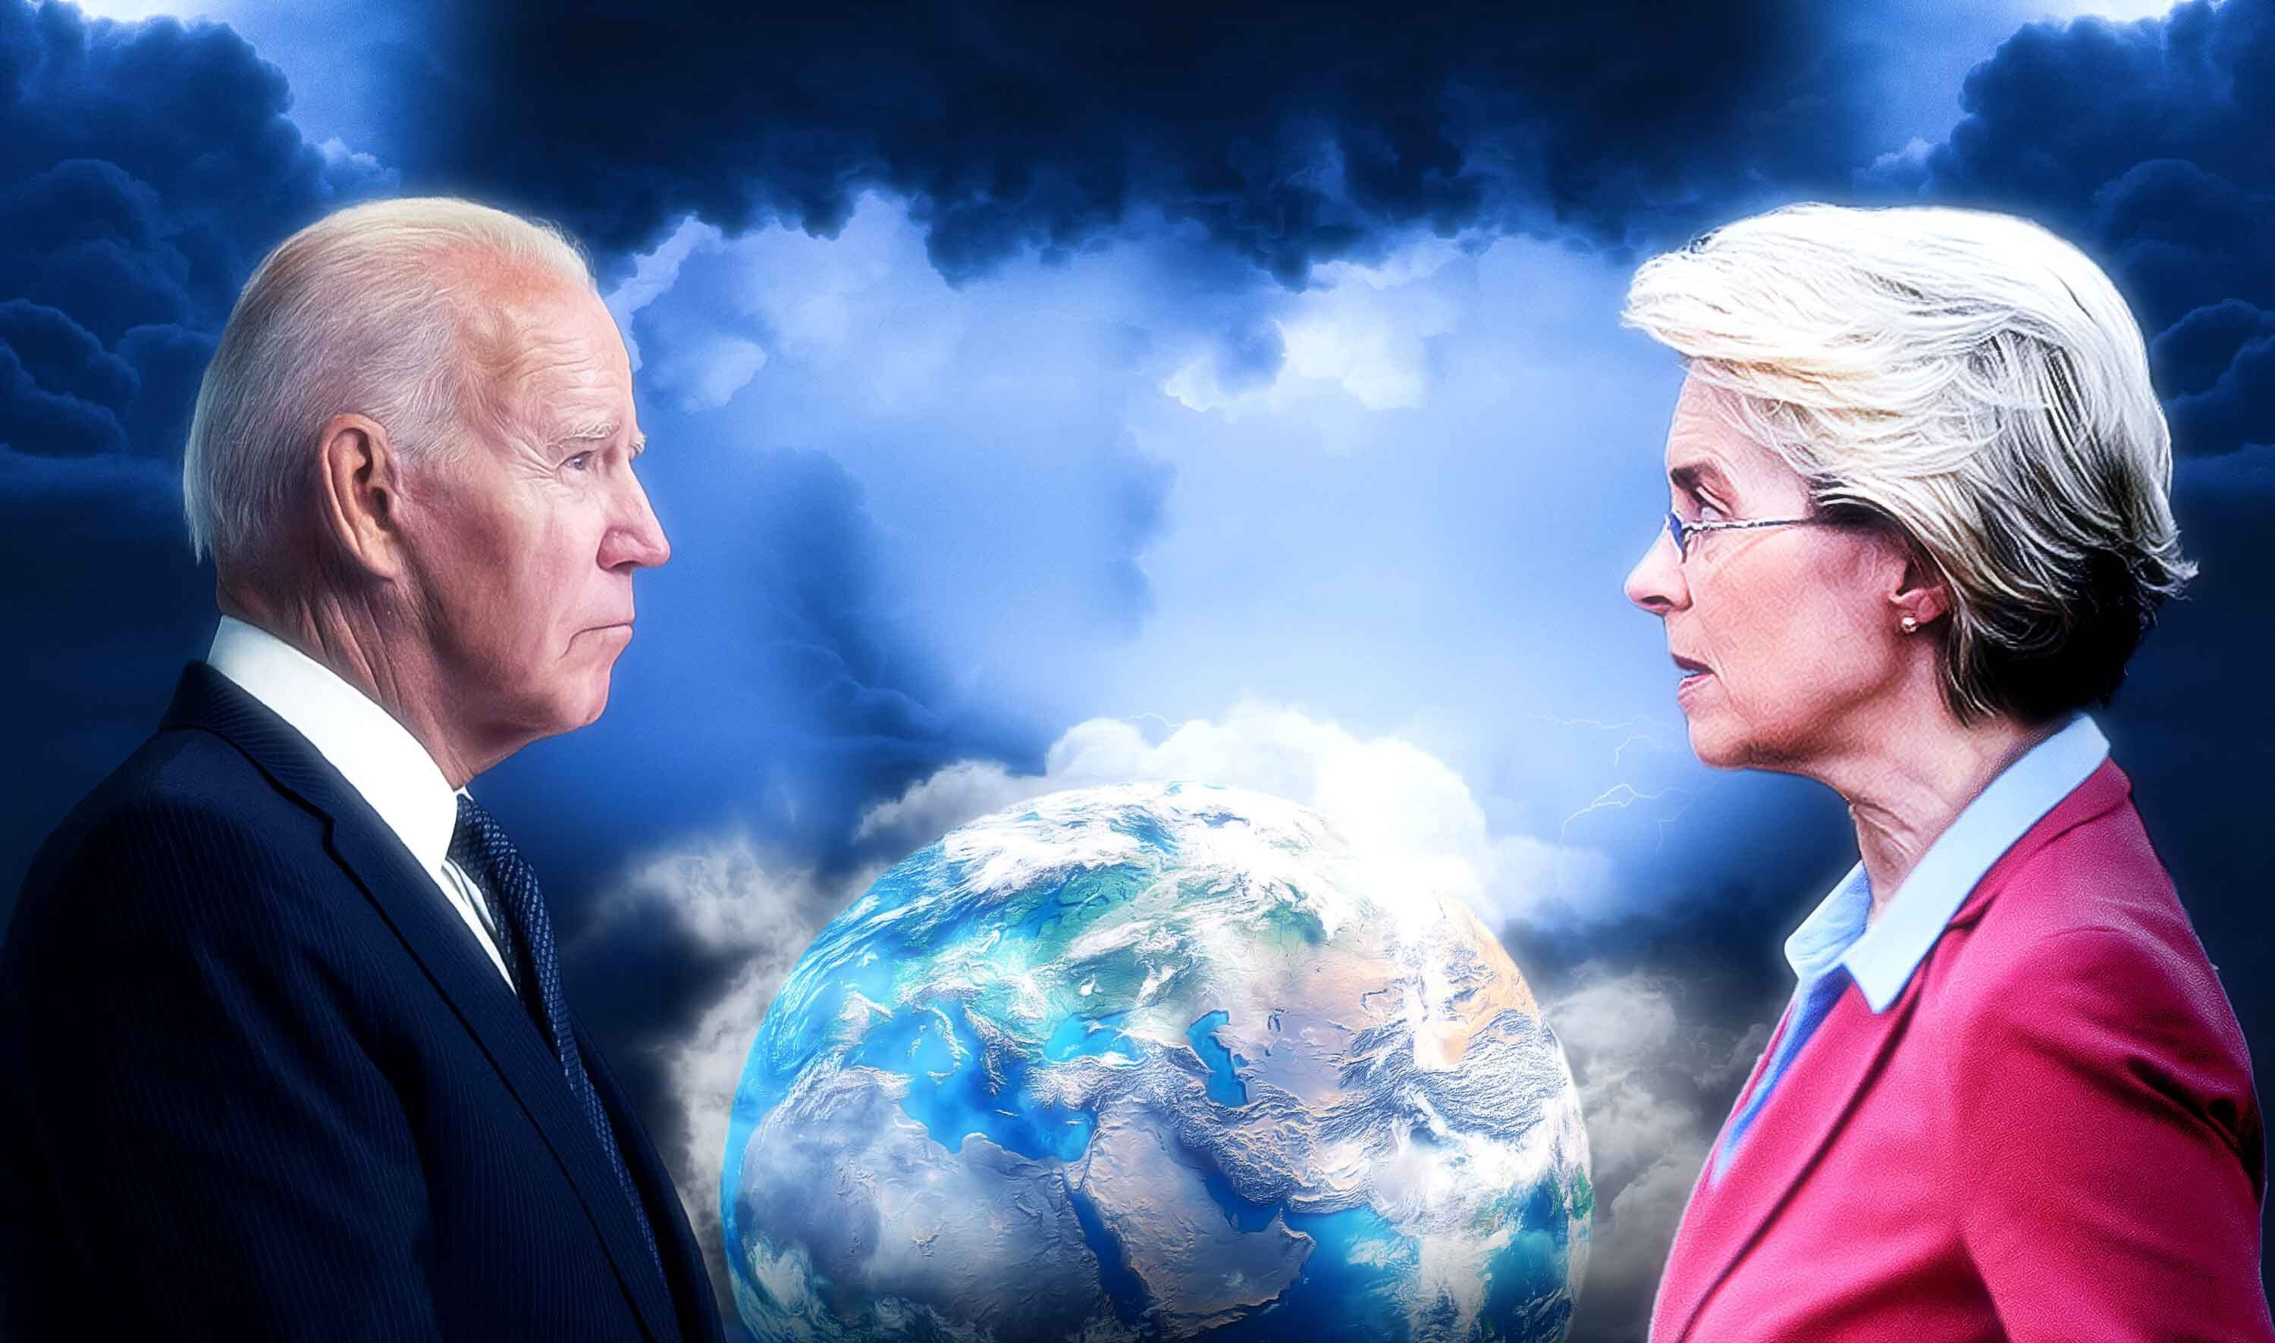
EU @ WTO MC 13

Slide 4
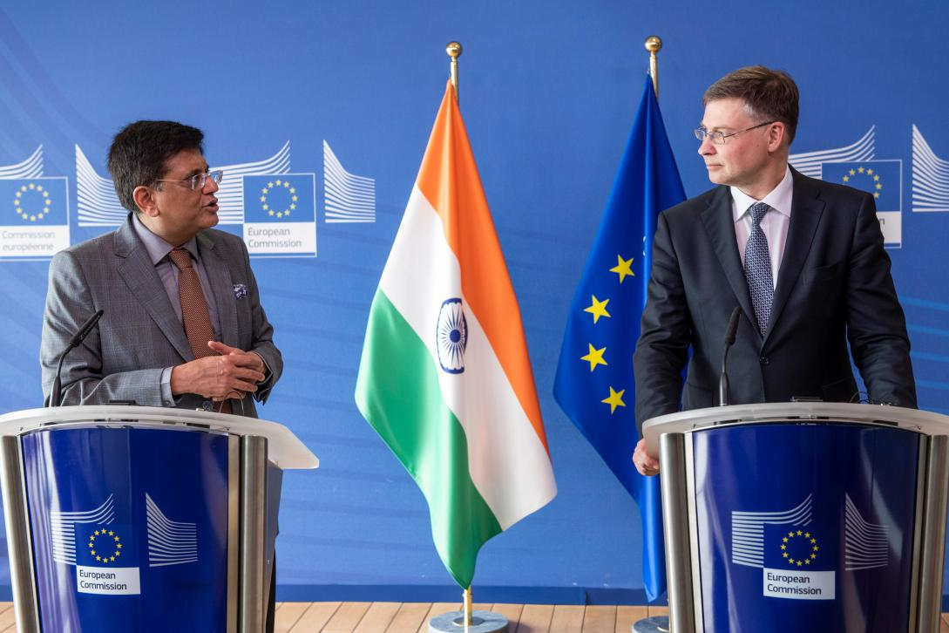
EU @ WTO MC 13
Selection of issues
EU market thinking
Tariff exemption for e-commerce
EU carbon border adjustment
Agriculture

Slide 5
Conclusion
Change of strategy?
Partnerships?
Connecting issues?

Slide 6
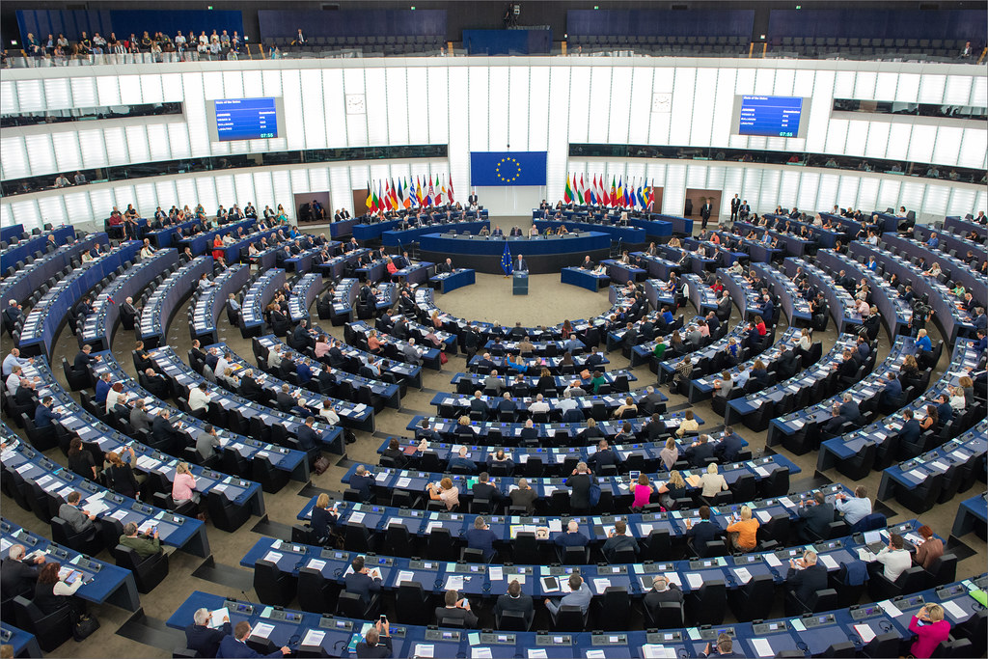
Thanks
Matthias Goldmann, Chair of International Law, EBS Law School, matthias.goldmann@ebs.edu

